Slide 1
Section 2.7: Apportionment
Math for Liberal Studies

Slide 2
Unequal Representation
The US Senate has 100 members: two for each state
In the US House of Representatives, states are represented based on population
PA has 19 representatives
Delaware has 1

Slide 3
Apportionment
The process by which seats are assigned based on population is called apportionment
The number of seats each state gets is also called that state’s apportionment

Slide 4
A Simple Example
Consider a fictional country with four states and a representative legislature with 50 seats
State | Population
Angria | 80,000
Bretonnia | 60,000
Curaguay | 40,000
Dennenberg | 20,000
Total | 200,000

Slide 5
A Simple Example
Each state should get a proportion of the seats that is equal to its proportion of the total population
State | Population
Angria | 80,000
Bretonnia | 60,000
Curaguay | 40,000
Dennenberg | 20,000
Total | 200,000

Slide 6
A Simple Example
Divide each state’s population by the total population to get the % population
State | Population | % Pop.
Angria | 80,000 | 40%
Bretonnia | 60,000 | 30%
Curaguay | 40,000 | 20%
Dennenberg | 20,000 | 10%
Total | 200,000 | 100%

Slide 7
A Simple Example
Multiply that percentage by the total number of seats (in this case 50) to get each state’s fair share of seats
State | Population | % Pop. | Fair Share
Angria | 80,000 | 40% | 20
Bretonnia | 60,000 | 30% | 15
Curaguay | 40,000 | 20% | 10
Dennenberg | 20,000 | 10% | 5
Total | 200,000 | 100% | 50

Slide 8
That’s Too Simple!
Real world examples rarely work out as nicely as the previous example did
Let’s use more realistic population numbers and see what happens

Slide 9
A Less Simple Example
We will start the problem in the same way
State | Population
Angria | 83,424
Bretonnia | 67,791
Curaguay | 45,102
Dennenberg | 17,249
Total | 213,566

Slide 10
A Less Simple Example
Divide each state’s population by the total population to get the % population
State | Population | % Pop.
Angria | 83,424 | 39.06%
Bretonnia | 67,791 | 31.74%
Curaguay | 45,102 | 21.12%
Dennenberg | 17,249 | 8.08%
Total | 213,566 | 100%

Slide 11
A Less Simple Example
Multiply that percentage by the total number of seats (in this case 50) to get each state’s fair share of seats
State | Population | % Pop. | Fair Share
Angria | 83,424 | 39.06% | 19.53
Bretonnia | 67,791 | 31.74% | 15.87
Curaguay | 45,102 | 21.12% | 10.56
Dennenberg | 17,249 | 8.08% | 4.04
Total | 213,566 | 100% | 50

Slide 12
A Less Simple Example
The problem is that we can’t assign a state 19.53 seats… each apportionment must be a whole number!
State | Population | % Pop. | Fair Share
Angria | 83,424 | 39.06% | 19.53
Bretonnia | 67,791 | 31.74% | 15.87
Curaguay | 45,102 | 21.12% | 10.56
Dennenberg | 17,249 | 8.08% | 4.04
Total | 213,566 | 100% | 50

Slide 13
A Less Simple Example
We could try rounding each fair share to the nearest whole number, but we end up with 51 seats, which is more than we have!
State | Population | % Pop. | Fair Share | Seats
Angria | 83,424 | 39.06% | 19.53 | 20
Bretonnia | 67,791 | 31.74% | 15.87 | 16
Curaguay | 45,102 | 21.12% | 10.56 | 11
Dennenberg | 17,249 | 8.08% | 4.04 | 4
Total | 213,566 | 100% | 50 | 51

Slide 14
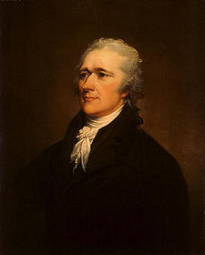
Hamilton’s Method
Named for Alexander Hamilton, who developed the method for apportioning the US House of Representatives
With Hamilton’s method, we start like we did before, and compute the fair shares

Slide 15
Hamilton’s Method
Here are the fair shares we computed before
Round each fair share down
State | Population | % Pop. | Fair Share
Angria | 83,424 | 39.06% | 19.53
Bretonnia | 67,791 | 31.74% | 15.87
Curaguay | 45,102 | 21.12% | 10.56
Dennenberg | 17,249 | 8.08% | 4.04
Total | 213,566 | 100% | 50

Slide 16
Hamilton’s Method
The rounded-down fair shares are called lower quotas
Each state should receive at least this number of seats
State | Population | % Pop. | Fair Share | Lower Quota
Angria | 83,424 | 39.06% | 19.53 | 19
Bretonnia | 67,791 | 31.74% | 15.87 | 15
Curaguay | 45,102 | 21.12% | 10.56 | 10
Dennenberg | 17,249 | 8.08% | 4.04 | 4
Total | 213,566 | 100% | 50 | 48

Slide 17
Hamilton’s Method
Notice that now we have 2 “leftover” seats that need to be assigned
State | Population | % Pop. | Fair Share | Lower Quota
Angria | 83,424 | 39.06% | 19.53 | 19
Bretonnia | 67,791 | 31.74% | 15.87 | 15
Curaguay | 45,102 | 21.12% | 10.56 | 10
Dennenberg | 17,249 | 8.08% | 4.04 | 4
Total | 213,566 | 100% | 50 | 48

Slide 18
Hamilton’s Method
The states that had the highest decimal part in their fair share get priority for the leftover seats
State | Population | % Pop. | Fair Share | Lower Quota
Angria | 83,424 | 39.06% | 19.53 | 19
Bretonnia | 67,791 | 31.74% | 15.87 | 15
Curaguay | 45,102 | 21.12% | 10.56 | 10
Dennenberg | 17,249 | 8.08% | 4.04 | 4
Total | 213,566 | 100% | 50 | 48

Slide 19
Hamilton’s Method
The states that had the highest decimal part in their fair share get priority for the leftover seats
State | Population | % Pop. | Fair Share | Lower Quota | Priority
Angria | 83,424 | 39.06% | 19.53 | 19
Bretonnia | 67,791 | 31.74% | 15.87 | 15 | 1st
Curaguay | 45,102 | 21.12% | 10.56 | 10
Dennenberg | 17,249 | 8.08% | 4.04 | 4
Total | 213,566 | 100% | 50 | 48

Slide 20
Hamilton’s Method
The states that had the highest decimal part in their fair share get priority for the leftover seats
State | Population | % Pop. | Fair Share | Lower Quota | Priority
Angria | 83,424 | 39.06% | 19.53 | 19
Bretonnia | 67,791 | 31.74% | 15.87 | 15 | 1st
Curaguay | 45,102 | 21.12% | 10.56 | 10 | 2nd
Dennenberg | 17,249 | 8.08% | 4.04 | 4
Total | 213,566 | 100% | 50 | 48

Slide 21
Hamilton’s Method
The states that had the highest decimal part in their fair share get priority for the leftover seats
State | Population | % Pop. | Fair Share | Lower Quota | Priority
Angria | 83,424 | 39.06% | 19.53 | 19 | 3rd
Bretonnia | 67,791 | 31.74% | 15.87 | 15 | 1st
Curaguay | 45,102 | 21.12% | 10.56 | 10 | 2nd
Dennenberg | 17,249 | 8.08% | 4.04 | 4
Total | 213,566 | 100% | 50 | 48

Slide 22
Hamilton’s Method
The states that had the highest decimal part in their fair share get priority for the leftover seats
State | Population | % Pop. | Fair Share | Lower Quota | Priority
Angria | 83,424 | 39.06% | 19.53 | 19 | 3rd
Bretonnia | 67,791 | 31.74% | 15.87 | 15 | 1st
Curaguay | 45,102 | 21.12% | 10.56 | 10 | 2nd
Dennenberg | 17,249 | 8.08% | 4.04 | 4 | 4th
Total | 213,566 | 100% | 50 | 48

Slide 23
Hamilton’s Method
Now, in priority order, we assign the extra seats
State | Population | % Pop. | Fair Share | Lower Quota | Priority | Seats
Angria | 83,424 | 39.06% | 19.53 | 19 | 3rd
Bretonnia | 67,791 | 31.74% | 15.87 | 15 | 1st
Curaguay | 45,102 | 21.12% | 10.56 | 10 | 2nd
Dennenberg | 17,249 | 8.08% | 4.04 | 4 | 4th
Total | 213,566 | 100% | 50 | 48

Slide 24
Hamilton’s Method
Now, in priority order, we assign the extra seats
State | Population | % Pop. | Fair Share | Lower Quota | Priority | Seats
Angria | 83,424 | 39.06% | 19.53 | 19 | 3rd
Bretonnia | 67,791 | 31.74% | 15.87 | 15 | 1st | 16
Curaguay | 45,102 | 21.12% | 10.56 | 10 | 2nd
Dennenberg | 17,249 | 8.08% | 4.04 | 4 | 4th
Total | 213,566 | 100% | 50 | 48

Slide 25
Hamilton’s Method
Now, in priority order, we assign the extra seats
State | Population | % Pop. | Fair Share | Lower Quota | Priority | Seats
Angria | 83,424 | 39.06% | 19.53 | 19 | 3rd
Bretonnia | 67,791 | 31.74% | 15.87 | 15 | 1st | 16
Curaguay | 45,102 | 21.12% | 10.56 | 10 | 2nd | 11
Dennenberg | 17,249 | 8.08% | 4.04 | 4 | 4th
Total | 213,566 | 100% | 50 | 48

Slide 26
Hamilton’s Method
We only had two leftover seats to assign, so the other states get their lower quota
State | Population | % Pop. | Fair Share | Lower Quota | Priority | Seats
Angria | 83,424 | 39.06% | 19.53 | 19 | 3rd
Bretonnia | 67,791 | 31.74% | 15.87 | 15 | 1st | 16
Curaguay | 45,102 | 21.12% | 10.56 | 10 | 2nd | 11
Dennenberg | 17,249 | 8.08% | 4.04 | 4 | 4th
Total | 213,566 | 100% | 50 | 48

Slide 27
Hamilton’s Method
We only had two leftover seats to assign, so the other states get their lower quota
State | Population | % Pop. | Fair Share | Lower Quota | Priority | Seats
Angria | 83,424 | 39.06% | 19.53 | 19 | 3rd | 19
Bretonnia | 67,791 | 31.74% | 15.87 | 15 | 1st | 16
Curaguay | 45,102 | 21.12% | 10.56 | 10 | 2nd | 11
Dennenberg | 17,249 | 8.08% | 4.04 | 4 | 4th | 4
Total | 213,566 | 100% | 50 | 48 |  | 50

Slide 28
The Quota Rule
Notice that Bretonnia and Curaguay received their fair shares rounded up (their upper quota)
State | Population | % Pop. | Fair Share | Lower Quota | Priority | Seats
Angria | 83,424 | 39.06% | 19.53 | 19 | 3rd | 19
Bretonnia | 67,791 | 31.74% | 15.87 | 15 | 1st | 16
Curaguay | 45,102 | 21.12% | 10.56 | 10 | 2nd | 11
Dennenberg | 17,249 | 8.08% | 4.04 | 4 | 4th | 4
Total | 213,566 | 100% | 50 | 48 |  | 50

Slide 29
The Quota Rule
With Hamilton’s method, each state will always receive either their lower quota or their upper quota: this is the quota rule
If a state is apportioned a number of states that is either above its upper quota or below its lower quota, then that is a quota rule violation

Slide 30
You Try It
Use Hamilton’s Method to assign 60 seats to the following states
State A has population 4,105
State B has population 5,376
State C has population 2,629

Slide 31
You Try It
Here is the solution
State | Population | % Pop. | Fair Share | Lower Quota | Priority | Seats
A | 4,105 | 33.90% | 20.34 | 20 | 2nd | 20
B | 5,376 | 44.39% | 26.64 | 26 | 1st | 27
C | 2,629 | 21.71% | 13.03 | 13 | 3rd | 13
Total | 12,110 | 100% | 60 | 59 |  | 60

Slide 32
Problems with Hamilton’s Method
Hamilton’s method is relatively simple to use, but it can lead to some strange paradoxes:
The Alabama paradox: Increasing the number of total seats causes a state to lose seats
The New States paradox: Introducing a new state causes an existing state to gain seats
The Population paradox: A state that gains population loses a seat to a state that does not

Slide 33
The Alabama Paradox
When the population of each state stays the same but the number of seats is increased, intuitively each state’s apportionment should stay the same or go up
That doesn’t always happen

Slide 34
The Alabama Paradox
Consider these state populations, with 80 seats available. Watch what happens when we increase to 81 seats
State | Population | % Pop. | Fair Share | Lower Quota | Priority | Seats
Angria | 83,424 | 39.06% | 31.25 | 31 |  | 31
Bretonnia | 67,791 | 31.74% | 25.39 | 25 |  | 25
Curaguay | 45,102 | 21.12% | 16.89 | 16 | 1st | 17
Dennenberg | 17,249 | 8.08% | 6.46 | 6 | 2nd | 7
Totals | 213,566 | 100% | 80 | 78 |  | 80

Slide 35
The Alabama Paradox
State | Population | % Pop. | Fair Share | Lower Quota | Priority | Seats
Angria | 83,424 | 39.06% | 31.25 | 31 |  | 31
Bretonnia | 67,791 | 31.74% | 25.39 | 25 |  | 25
Curaguay | 45,102 | 21.12% | 16.89 | 16 | 1st | 17
Dennenberg | 17,249 | 8.08% | 6.46 | 6 | 2nd | 7
Totals | 213,566 | 100% | 80 | 78 |  | 80
State | Population | % Pop. | Fair Share | Lower Quota | Priority | Seats
Angria | 83,424 | 39.06% | 31.64 | 31 | 2nd | 32
Bretonnia | 67,791 | 31.74% | 25.71 | 25 | 1st | 26
Curaguay | 45,102 | 21.12% | 17.11 | 17 |  | 17
Dennenberg | 17,249 | 8.08% | 6.54 | 6 |  | 6
Totals | 213,566 | 100% | 81 | 79 |  | 81

Slide 36
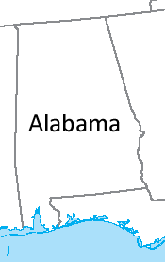
The Alabama Paradox
After the 1880 Census, it was time to reapportion the House of Representatives.
The chief clerk of the Census Bureau computed apportionments for all numbers of seats from 275 to 350.
Alabama would receive 8 seats if there were 299 total seats, but only 7 seats if 300 were available.

Slide 37
The New States Paradox
If a new state is added to our country, but the total number of seats remains the same, then we would expect that the apportionment for the existing states should stay the same or go down
This doesn’t always happen

Slide 38
The New States Paradox
Consider this country with 4 states and 70 seats
State | Population | % Pop. | Fair Share | Lower Quota | Priority | Seats
Elkabar | 80,424 | 39.80% | 27.86 | 27 | 1st | 28
Florin | 59,902 | 29.64% | 20.75 | 20 | 2nd | 21
Gondor | 48,338 | 23.92% | 16.75 | 16 | 3rd | 17
Hyrkania | 13,405 | 6.63% | 4.64 | 4 |  | 4
Totals | 202,069 | 100% | 70 | 67 |  | 70

Slide 39
The New States Paradox
Now suppose the small state of Ishtar is added to this country
State | Population | % Pop. | Fair Share | Lower Quota | Priority | Seats
Elkabar | 80,424 | 39.80% | 27.86 | 27 | 1st | 28
Florin | 59,902 | 29.64% | 20.75 | 20 | 2nd | 21
Gondor | 48,338 | 23.92% | 16.75 | 16 | 3rd | 17
Hyrkania | 13,405 | 6.63% | 4.64 | 4 |  | 4
Totals | 202,069 | 100% | 70 | 67 |  | 70

Slide 40
The New States Paradox
State | Population | % Pop. | Fair Share | Lower Quota | Priority | Seats
Elkabar | 80,424 | 39.80% | 27.86 | 27 | 1st | 28
Florin | 59,902 | 29.64% | 20.75 | 20 | 2nd | 21
Gondor | 48,338 | 23.92% | 16.75 | 16 | 3rd | 17
Hyrkania | 13,405 | 6.63% | 4.64 | 4 |  | 4
Totals | 202,069 | 100% | 70 | 67 |  | 70
State | Population | % Pop. | Fair Share | Lower Quota | Priority | Seats
Elkabar | 80,424 | 38.72% | 27.11 | 27 |  | 27
Florin | 59,902 | 28.84% | 20.19 | 20 |  | 20
Gondor | 48,338 | 23.28% | 16.29 | 16 |  | 16
Hyrkania | 13,405 | 6.45% | 4.52 | 4 | 2nd | 5
Ishtar | 5,611 | 2.70% | 1.89 | 1 | 1st | 2
Totals | 207,680 | 100% | 70 | 68 |  | 70

Slide 41
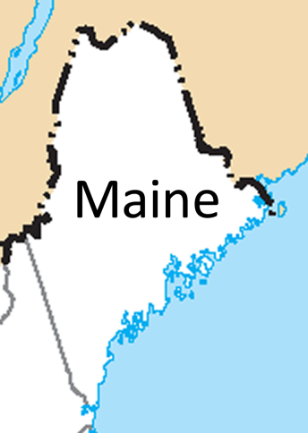
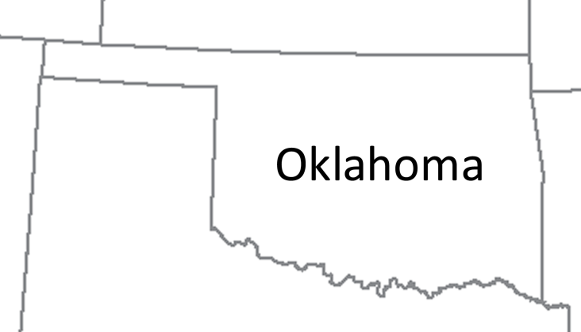
The New States Paradox
In 1907, when Oklahoma was admitted to the Union, the total number of seats in Congress did not change
Oklahoma was assigned 5 seats, but this resulted in Maine gaining a seat!

Slide 42
The Population Paradox
As time goes on, populations of states change
States that increase population rapidly should gain seats over those that do not
However, this doesn’t always happen

Slide 43
The Population Paradox
Consider this country with 4 states and 100 seats
State | Population | % Pop. | Fair Share | Lower Quota | Priority | Seats
Javasu | 28,900 | 18.09% | 18.09 | 18 |  | 18
Karjastan | 76,200 | 47.68% | 47.68 | 47 | 1st | 48
Libria | 44,200 | 27.66% | 27.66 | 27 | 2nd | 28
Malbonia | 10,500 | 6.57% | 6.57 | 6 |  | 6
Totals | 159,800 | 100% | 100 | 98 |  | 100

Slide 44
The Population Paradox
Suppose that the populations of the states change
State | Population | % Pop. | Fair Share | Lower Quota | Priority | Seats
Javasu | 28,900 | 18.09% | 18.09 | 18 |  | 18
Karjastan | 76,200 | 47.68% | 47.68 | 47 | 1st | 48
Libria | 44,200 | 27.66% | 27.66 | 27 | 2nd | 28
Malbonia | 10,500 | 6.57% | 6.57 | 6 |  | 6
Totals | 159,800 | 100% | 100 | 98 |  | 100

Slide 45
The Population Paradox
State | Population | % Pop. | Fair Share | Lower Quota | Priority | Seats
Javasu | 28,900 | 18.09% | 18.09 | 18 |  | 18
Karjastan | 76,200 | 47.68% | 47.68 | 47 | 1st | 48
Libria | 44,200 | 27.66% | 27.66 | 27 | 2nd | 28
Malbonia | 10,500 | 6.57% | 6.57 | 6 |  | 6
Totals | 159,800 | 100% | 100 | 98 |  | 100
State | Population | % Pop. | Fair Share | Lower Quota | Priority | Seats
Javasu | 28,900 | 17.97% | 17.97 | 17 | 2nd | 18
Karjastan | 76,400 | 47.51% | 47.51 | 47 |  | 47
Libria | 45,000 | 27.99% | 27.99 | 27 | 1st | 28
Malbonia | 10,500 | 6.53% | 6.53 | 6 | 3rd | 7
Totals | 160,800 | 100% | 100 | 97 |  | 100

Slide 46
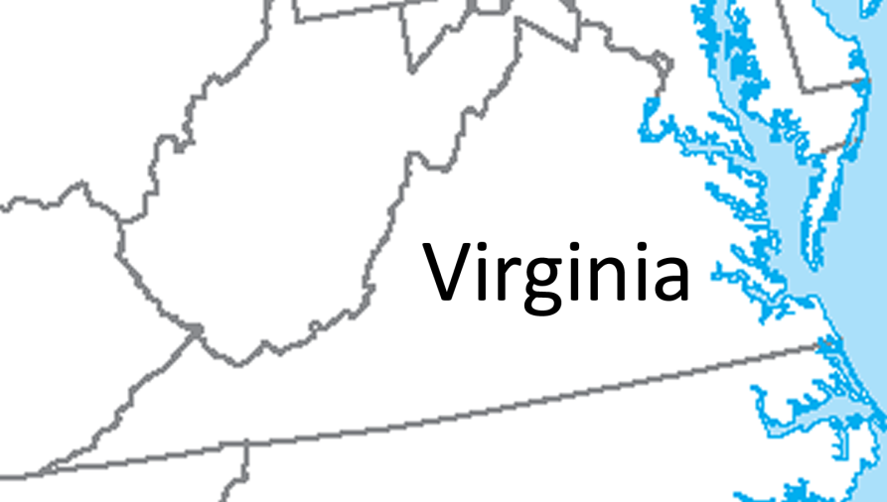
The Population Paradox
In the 1901 apportionment, Virginia lost a seat to Maine even though Virginia’s population grew at a faster rate!

Slide 47
Alternative Apportionment Methods
Several alternatives to Hamilton’s method have been developed that avoid these paradoxes
The first was developed by Thomas Jefferson, and was the method used to apportion the Congress from 1792 to 1832

Slide 48
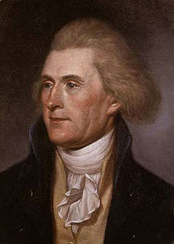
Jefferson’s Method
With this method, we return to Hamilton’s idea of rounding down the fair shares
The trick is to round down the fair shares, but not have any leftover seats

Slide 49
Jefferson’s Method
Consider this example
State | Population | % Pop. | Fair Share | Lower Quota
Angria | 87,438 | 29.15% | 14.58 | 14
Bretonnia | 82,511 | 27.50% | 13.75 | 13
Curaguay | 66,942 | 22.31% | 11.16 | 11
Dennenberg | 63,109 | 21.04% | 10.52 | 10
Total | 300,000 | 100% | 50 | 48

Slide 50
Jefferson’s Method
Here we have two extra seats, and each seat represents 300,000/50 = 6,000 people
State | Population | % Pop. | Fair Share | Lower Quota
Angria | 87,438 | 29.15% | 14.58 | 14
Bretonnia | 82,511 | 27.50% | 13.75 | 13
Curaguay | 66,942 | 22.31% | 11.16 | 11
Dennenberg | 63,109 | 21.04% | 10.52 | 10
Total | 300,000 | 100% | 50 | 48

Slide 51
Jefferson’s Method
When we divide the total population by the number of seats, we get the standard divisor
Instead of figuring out the % population, we could just divide the population of each state by the standard divisor

Slide 52
Jefferson’s Method
For example, Angria’s fair share is 87,438/6,000 = 14.58
State | Population | Fair Share | Lower Quota
Angria | 87,438 | 14.58 | 14
Bretonnia | 82,511 | 13.75 | 13
Curaguay | 66,942 | 11.16 | 11
Dennenberg | 63,109 | 10.52 | 10
Total | 300,000 | 50 | 48

Slide 53
Jefferson’s Method
Jefferson’s idea was to modify the standard divisor so that when the shares for each state are rounded down, there are no leftover seats
Right now we are only assigning 48 seats
Making the divisor smaller will increase each state’s share

Slide 54
Jefferson’s Method
Here is the apportionment with the original divisor (6,000)
State | Population | Fair Share | Lower Quota
Angria | 87,438 | 14.58 | 14
Bretonnia | 82,511 | 13.75 | 13
Curaguay | 66,942 | 11.16 | 11
Dennenberg | 63,109 | 10.52 | 10
Total | 300,000 | 50 | 48

Slide 55
Jefferson’s Method
Let’s make the divisor smaller
Here we have the divisor equal to 5,850
State | Population | Modified Share | Lower Quota
Angria | 87,438 | 14.95 | 14
Bretonnia | 82,511 | 14.10 | 14
Curaguay | 66,942 | 11.44 | 11
Dennenberg | 63,109 | 10.79 | 10
Totals | 300,000 |  | 49
Still not enough seats!

Slide 56
Jefferson’s Method
Let’s make the divisor even smaller
Here we have the divisor equal to 5,700
State | Population | Modified Share | Lower Quota
Angria | 87,438 | 15.34 | 15
Bretonnia | 82,511 | 14.48 | 14
Curaguay | 66,942 | 11.74 | 11
Dennenberg | 63,109 | 11.07 | 11
Totals | 300,000 |  | 51
Now we have too many seats!

Slide 57
Jefferson’s Method
With some trial and error we find a number that works (in this case 5,800)
State | Population | Modified Share | Lower Quota
Angria | 87,438 | 15.08 | 15
Bretonnia | 82,511 | 14.23 | 14
Curaguay | 66,942 | 11.54 | 11
Dennenberg | 63,109 | 10.88 | 10
Totals | 300,000 |  | 50
Success!

Slide 58
Problems with Jefferson’s Method
Jefferson’s method has the advantage that it doesn’t suffer from any of the paradoxes that Hamilton’s method did
However, there is still a problem with Jefferson’s method
Let’s consider another example with 4 states and 50 seats

Slide 59
Problems with Jefferson’s Method
This time the standard divisor is 220,561/50 = 4,411.2
State | Population | Fair Share | Lower Quota
Elkabar | 96,974 | 21.98 | 21
Florin | 45,902 | 10.41 | 10
Gondor | 44,921 | 10.18 | 10
Hyrkania | 32,764 | 7.43 | 7
Totals | 220,561 | 50 | 48

Slide 60
Problems with Jefferson’s Method
We have leftover seats, so Jefferson’s method tells us to make the divisor smaller
State | Population | Fair Share | Lower Quota
Elkabar | 96,974 | 21.98 | 21
Florin | 45,902 | 10.41 | 10
Gondor | 44,921 | 10.18 | 10
Hyrkania | 32,764 | 7.43 | 7
Totals | 220,561 | 50 | 48

Slide 61
Problems with Jefferson’s Method
After some trial and error, we find that a divisor of 4,200 works
State | Population | Modified Share | Lower Quota
Elkabar | 96,974 | 23.09 | 23
Florin | 45,902 | 10.93 | 10
Gondor | 44,921 | 10.70 | 10
Hyrkania | 32,764 | 7.80 | 7
Totals | 220,561 |  | 50

Slide 62
Problems with Jefferson’s Method
State | Population | Fair Share | Lower Quota
Elkabar | 96,974 | 21.98 | 21
Florin | 45,902 | 10.41 | 10
Gondor | 44,921 | 10.18 | 10
Hyrkania | 32,764 | 7.43 | 7
Totals | 220,561 | 50 | 48
The top chart uses the standard divisor (4,411)
The bottom chart is our Jefferson’s method solution
We have a quota rule violation!
State | Population | Modified Share | Lower Quota
Elkabar | 96,974 | 23.09 | 23
Florin | 45,902 | 10.93 | 10
Gondor | 44,921 | 10.70 | 10
Hyrkania | 32,764 | 7.80 | 7
Totals | 220,561 |  | 50

Slide 63
Alternatives to the Alternative
As we saw, Jefferson’s method can violate the quota rule
This tends to favor larger states over smaller ones

Slide 64
Alternatives to the Alternative
Variations of Jefferson’s method were proposed
Adams’ method (developed by the 6th US President John Quincy Adams)
Webster’s method (developed by famed orator and lawyer Daniel Webster)

Slide 65
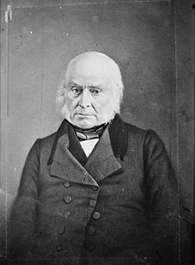
Adams’ Method
This method is the same as Jefferson’s method, except you always round the shares up instead of down
This gives you too many seats, so you need to increase the divisor until you get the right number of seats

Slide 66
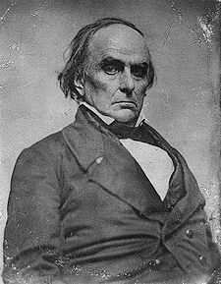
Webster’s Method
In this method, we round the shares to the nearest whole number
It’s possible that this gives us the right number of seats, in which case we’re done
Otherwise, we need to increase (if we have too few seats) or decrease (if we have too many seats) the divisor

Slide 67
Impossibility… Again
Even these alternative methods can cause quota rule violations
In fact, it was proved in 1980 that it is impossible to find an apportionment system that both
avoids the paradoxes we discussed
doesn’t violate the quota rule

